Slide 1
Device/Cloud Collaboration Framework
Cloud computing is now an established computing paradigm that offers on-demand computing and storage resources to the users who cannot afford the expenditure on computing equipment and management workforce.
We need a cloud-computing framework that improves both the scalability and the privacy-protection mechanism.
At a high level, this framework leverages the compute and storage resources
Also, this framework enables security solutions that protect privacy without degrading the quality of applications.
Device/Cloud collaboration framework is a Framework that enables collaboration between smart mobile devices and cloud for a more scalable and secure computing mechanism.

Slide 2
…Device/Cloud Collaboration Framework
Powerful smart mobile devices
Smart phones nowadays have enough computing capacity to process various computing tasks.
However, the device usage can be constrained by limited battery life and network connectivity.
Therefore, we can consider utilizing the highly available cloud resources in addition to the device.

Slide 3
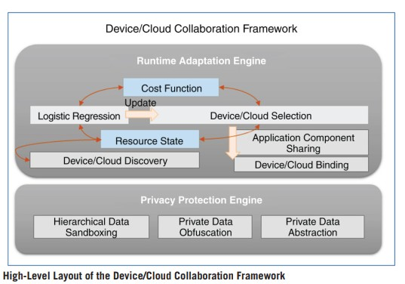

Slide 4
Runtime Adaptation Engine
For a given a computation task, framework needs to choose the entity to execute the task.
For eg, we are given a task of processing a query issued over voice, and assume that we have a lightweight mobile version of a voice-query processing engine that is embedded in a Smartphone
This mobile engine can answer the given query without the cost of
transferring the voice data to the cloud over the network.
But, it will consume the limited battery life of the device
If the lightweight voice-query engine returns a poor result, then the user may have to issue the query redundantly to the cloud-based query processing engine with the hope of getting a better result.
This may hurt the overall quality of experience (QoE).

Slide 5
…Runtime Adaptation Engine
So we require a decision mechanism that automatically selects a better agent that can execute a given task.
Runtime Adaptation Engine (RAE) sits at the core of the framework.
The RAE maintains a list of available devices and cloud to utilize Device/Cloud Discovery, and monitors the state of their available resources.
The RAE employs a Logistic Regression algorithm to learn the most cost-effective policy for distributing tasks among devices and cloud, given the resource state.

Slide 6
…Runtime Adaptation Engine
Definition of the cost function is the weighted sum of the resource state (battery life, network, and CPU usage…)
The policy obtained by running the Logistic Regression is enforced by the Device/Cloud Selection module that chooses the most economical compute resources, based on the expected cost-value for a given task.
The mechanism of the RAE is an autonomous agent, which can be
deployed on each device and cloud.
RAEs communicate with each other to transparently share the resource state for determining the ways to distribute a given workload.

Slide 7
…Runtime Adaptation Engine
The cloud-side RAE advises the device-side RAE to either execute the task within the device or simply wait for the compute resource on the cloud.
The RAEs on the devices and the cloud make decisions autonomously, without any supporting brokerage system in the middle.

Slide 8
…Runtime Adaptation Engine
Device-side RAE has the burden of periodically monitoring the state of the cloud resources.
But ,the cloud-side RAE does not have to monitor the resource state of the millions of paired devices, as the cloud makes a relatively simple decision, that is, to either reject or accept a task- execution request.

Slide 9
…Runtime Adaptation Engine
Device/Cloud Discovery component:
To support task distribution among the neighbouring devices, the device/cloud collaboration framework implements discovery of devices
Application Component Sharing :
Suppose device A wants to collaborate with its neighbouring device B which is not equipped with appropriate application components to process a given task. Then, device A can transfer the necessary application components to device-B through the Application Component Sharing

Slide 10
Privacy-Protection Solution
Our framework employs the technology of protecting privacy by sandboxing hierarchically organized application-data. This technology, implemented in the Hierarchical Data Sandboxing module
Another solution is obfuscating (encrypting) data to be transferred to the neighboring devices or to the cloud. A natural solution is to encrypt the data upon transferring to cloud

Slide 11
Applications Of Device/Cloud Collaboration
Device/collaboration framework can be used by the real-world intelligence applications developed specifically at Samsung Electronics.
The selected applications offer the following functionalities:
context-aware proactive suggestion
semantic QA caching
automatic image/speech recognition

Slide 12
Semantic QA Caching
Semantic QA cache is a mobile application that retrieves answers to a given query from the cache filled with answers to the semantically similar queries issued in the past.
Semantic QA cache can be useful when there is no Internet connectivity or when the user is not in favour of transferring private queries to the cloud.
Semantic QA cache returns a list of similar queries and the
associated answers.
Semantic QA cache constantly updates ranking function
based on the word-translation table. The ranking function measures the similarity between a newly issued query and the queries measured in the past.

Slide 13
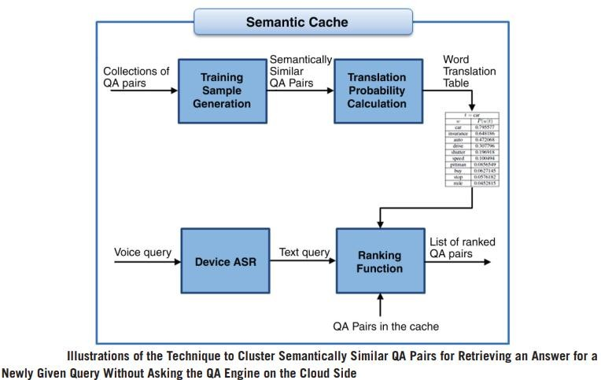

Slide 14
